Slide 1
Diagnostic Model using Neuroimages for Stroke Identification A Machine Learning Approach
Guide Project Coordinator By
Mrs.Satya Sudha Mrs. G.Sri Sudha Ayushman Sharma - 21AG1A6669
Assistant Professor Assistant Professor Preetham Reddy - 21AG1A6667
K. Roja - 21AG1A6687

Slide 2
Abstract
Stroke is a serious medical condition that requires timely and accurate diagnosis to improve patient outcomes.
Stroke identification involves detecting the stroke from dataset and classifying stroke types from neuroimages. Strokes can be ischemic (caused by blood clots) or hemorrhagic (caused by bleeding). This project aims to develop a machine learning model for detection of stroke as well as identify and classify strokes using neuroimages such as MRI and CT scans. The process involves collecting neuroimaging data, preprocessing the images, and extracting relevant features. Various machine learning algorithms, particularly convolutional neural networks (CNNs), are trained to recognize patterns in the images that indicate different types of strokes. The model is evaluated using metrics like accuracy and precision to ensure its reliability. Ultimately, the goal is to create a system that can assist healthcare professionals in diagnosing strokes quickly and accurately, potentially improving treatment decisions and patient care. Early and accurate detection is crucial for effective treatment.

Slide 3
Literature Survey Overview
S.No | Author/Year/Title | Methodology | Pros/Cons
1 | A. Khosla, Y. Cao, C. C.-Y. Lin, H.-K. Chiu, J. Hu, and H. Lee, 2010, An integrated machine learning approach to stroke prediction | Used multiple machine learning algorithms for stroke prediction. | Pro: Effective for large datasets. Con: Complex model.
2 | Y. Xu, K. Li, Y. Zhao, L. Zhou, Y. Liu, and J. Zhao, 2023, Role of ferroptosis in stroke | Explored the role of ferroptosis in stroke progression. | Pro: Novel approach; Con: Limited to animal studies.
3 | X. Li and G. Chen, 2023, CNS-peripheral immune interactions in hemorrhagic stroke | Analyzed CNS and peripheral immune responses in hemorrhagic stroke. | Pro: Detailed analysis of immune responses; Con: Lack of real-time data.
4 | Y. Yang, J. Zheng, Z. Du, Y. Li, and Y. Cai, 2021, Accurate prediction of stroke for hypertensive patients | Medical big data analysis using machine learning for stroke prediction. | Pro: Utilizes medical big data; Con: Specific to hypertensive patients.
5 | M. Chun, R. Clarke, B. J. Cairns, et al., 2021, Stroke risk prediction using machine learning: A cohort study | Large-scale cohort analysis with machine learning for stroke risk prediction. | Pro: Large dataset; Con: Limited geographical focus (Chinese adults).

Slide 4
6 | G. Ntaios, D. Sagris, A. Kallipolitis, et al., 2021, Machine-learning-derived model for the stratification of cardiovascular risk | Machine learning model for cardiovascular risk assessment in stroke patients. | Pro: Cardiovascular risk stratification; Con: Only ischemic stroke patients.
7 | K. Uchida, J. Kouno, S. Yoshimura, et al., 2022, Development of machine learning models to predict stroke types | Developed ML models for stroke prediction in the prehospital stage. | Pro: Accurate prediction at prehospital stage; Con: Limited generalization.
8 | S. Bacchi, T. Zerner, L. Oakden-Rayner, et al., 2020, Deep learning in stroke thrombolysis functional outcomes prediction | Deep learning techniques applied to predict stroke outcomes. | Pro: Accurate outcomes prediction; Con: Requires extensive computation.
9 | M. Saritha, K. Paul Joseph, and A. T. Mathew, 2013, Classification of MRI brain images using neural network | Wavelet entropy and neural networks used to classify MRI brain images. | Pro: High classification accuracy; Con: Computationally intensive.
10 | S. Gudadhe, A. Thakare, and A. M. Anter, 2023, Novel method for classifying intracranial hemorrhage CT images | Feature extraction method for classifying intracranial hemorrhage CT images. | Pro: Novel feature extraction method; Con: Limited dataset.

Slide 5
Existing System
Stroke is a leading cause of death and long-term disability worldwide, affecting millions annually. It can lead to severe neurological damage if not treated promptly.
The early diagnosis of strokes can create a greater impact on patient outcomes.
Currently, the identification of strokes heavily depends on the visual examination of neuroimages (e.g., CT or MRI scans) by radiologists and medical professionals. These images are often subject to varying interpretations depending on the skill and experience of the professional involved.
Stroke identification is a time-sensitive process. Manual interpretation of images may result in delays, especially in emergency situations. The longer the delay in diagnosis, the greater the risk of permanent damage to the brain.

Slide 6
Disadvantages
Despite the progress made in using machine learning models for stroke diagnosis, several challenges remain:
Limited availability of diverse and large-scale datasets, particularly from different demographic backgrounds.
High variability in neuroimage quality, making it difficult for models to generalize.
Lack of real-time diagnostic systems integrating neuroimage analysis with clinical data for comprehensive stroke detection.
Highly skilled radiologists are required to interpret neuroimages, which may not always be available, especially in resource-limited settings or during emergencies.
The time taken for image interpretation can delay the treatment process, which is critical in acute stroke management.

Slide 7
Proposed System
The proposed system leverages machine learning techniques to analyze neuroimages and automatically detect strokes with high accuracy.
Utilizing multiple datasets from different institutions to increase data diversity and improve model generalization.
Applying advanced data augmentation and image enhancement techniques to handle variability in neuroimage quality.
Developing a real-time diagnostic tool that integrates neuroimage analysis with clinical data for comprehensive stroke diagnosis.
The proposed system can be integrated with existing hospital information systems (HIS) to streamline the workflow for medical professionals, allowing them to focus on other critical aspects of patient care.

Slide 8
Advantages
Speed and Efficiency:
The automated system significantly reduces the time required for stroke diagnosis, allowing for rapid intervention and improving patient outcomes.
Consistency and Accuracy:
By using machine learning models trained on large datasets, the system provides consistent and accurate results, reducing variability across different medical professionals.
Resource Optimization:
The system can assist radiologists in resource-limited settings, where access to skilled professionals may be constrained.
Early Detection:
The system can potentially detect early signs of stroke that may be missed by the human eye, leading to quicker and more accurate treatment.

Slide 9

Requirements
Hardware:
- GPU-enabled system for training (e.g., NVIDIA GTX 1080 or higher)
- RAM (16GB or higher)
Software:
- Python 3.x
- TensorFlow, Keras, PyTorch
- SimpleITK, nibabel for neuroimage processing
- Jupyter Notebook, Google Colab
- Operating System: Linux/Windows

Slide 10
Architecture

Slide 11
Modules
These are the modules which are in our project
Data Acquisition Module
Preprocessing Module
Segmentation Module
Augmentation Module
Feature Extraction Module
Machine Learning Module
Classification Module
Post-Processing and Evaluation Module

Slide 12

Data Acquisition Module
The Data Acquisition Module is the initial phase of the system, responsible for collecting neuroimages required for stroke identification. These images can come from various medical imaging modalities, primarily MRI (Magnetic Resonance Imaging) or CT (Computed Tomography) scans, which are commonly used for diagnosing strokes. This module interfaces with hospital databases, local storage, or PACS (Picture Archiving and Communication Systems) to access neuroimages in standard formats like DICOM (Digital Imaging and Communications in Medicine) or JPEG. Effective data acquisition is crucial for ensuring the system receives high-quality, diverse neuroimages that will train the machine learning models, making them more accurate in identifying strokes across different scenarios.

Slide 13

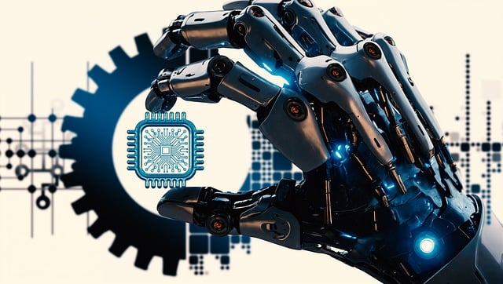
Preprocessing Module
The Preprocessing Module plays a critical role in enhancing the quality of the neuroimages before they are analyzed by machine learning algorithms. Raw neuroimages often contain noise or imperfections that could affect the accuracy of the system. This module applies various techniques such as noise reduction (using filters like Gaussian or median filters), contrast enhancement (using methods like histogram equalization), and image normalization to standardize pixel values. Additionally, images might be resized, cropped, or centered on regions of interest, such as specific brain areas, to focus the analysis on the most relevant portions. Preprocessing improves the clarity and usability of the images, ensuring the machine learning models can detect patterns more effectively.

Slide 14

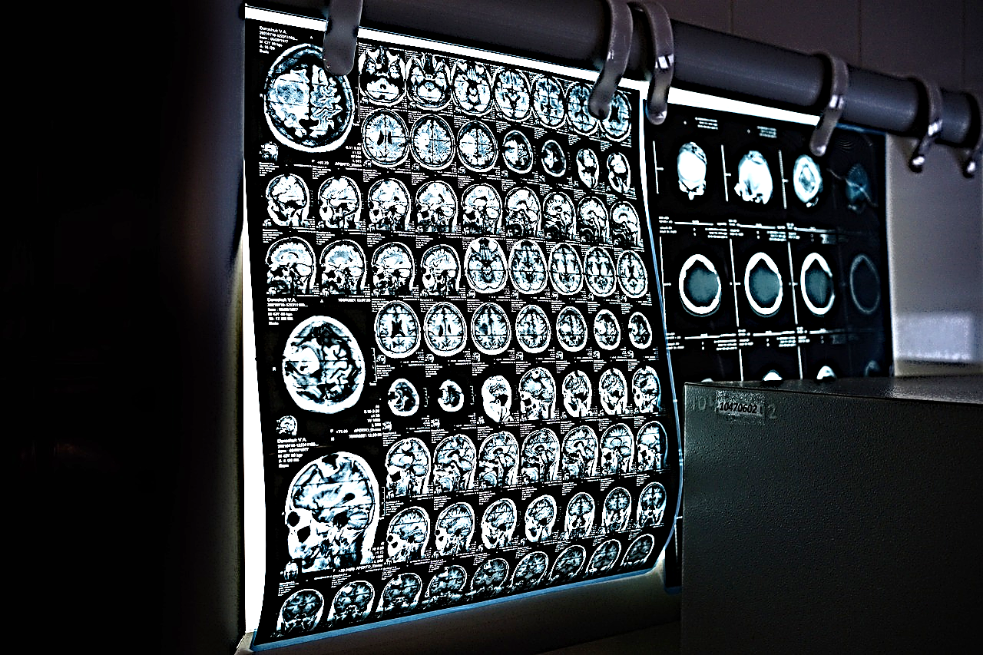
Segmentation Module
The Segmentation Module is crucial for isolating and identifying the regions of the brain most relevant to stroke analysis. Segmentation divides the neuroimage into different segments, such as brain tissues, lesions, and potential stroke-affected areas. It can use threshold-based methods for detecting intensity differences or advanced algorithms like U-Net, a deep learning architecture for pixel-wise segmentation. This module helps focus the analysis on specific regions of interest, such as ischemic (low blood supply) or hemorrhagic (bleeding) areas. Accurately segmenting the brain tissues and lesions ensures that the model can identify stroke-affected areas with higher precision, which is vital for diagnosis.

Slide 15

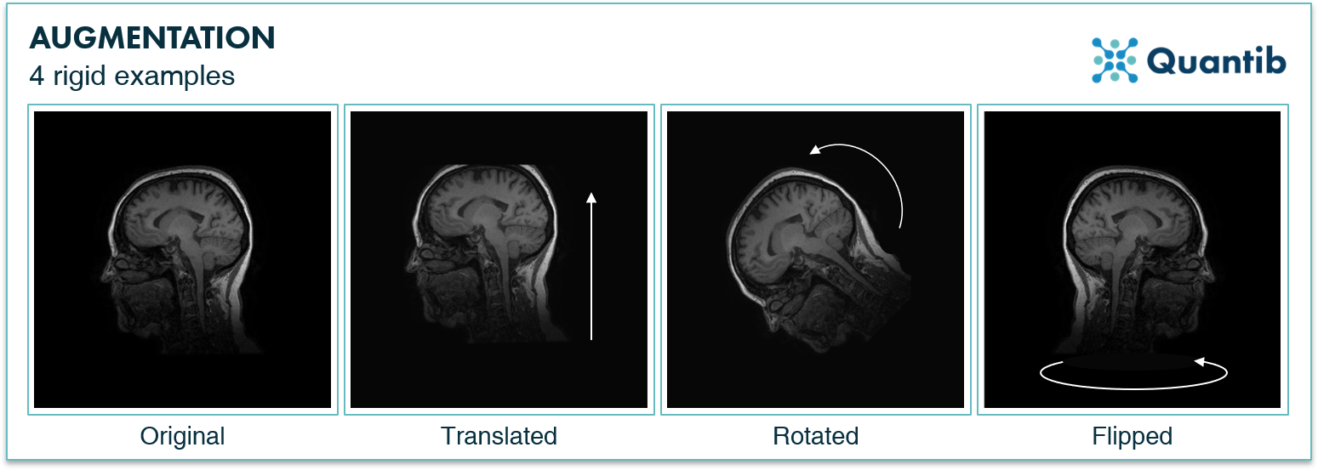
Augmentation Module
The Augmentation Module is designed to increase the size and diversity of the dataset, which is especially useful when working with limited neuroimage data. This module generates new images by applying various transformations to the existing images, such as rotations, flips, scaling, zooming, or adding small amounts of noise. These augmented images help the machine learning models generalize better by exposing them to a wider variety of cases. Augmentation not only reduces overfitting (where the model performs well on training data but poorly on new data) but also ensures the model can identify strokes under different imaging conditions and orientations, enhancing its robustness.

Slide 16

Feature Extraction Module
The Feature Extraction Module is responsible for converting neuroimages into numerical representations that machine learning models can process. It extracts important features from the images, such as texture patterns, intensity levels, shape, and size descriptors of lesions or abnormal brain tissues. Some feature extraction methods might rely on traditional techniques like Grey Level Co-occurrence Matrix (GLCM) to analyze textures, while more advanced systems may employ convolutional layers in CNNs to automatically learn hierarchical features from the images. The features extracted are critical for distinguishing between normal and stroke-affected areas in the brain and serve as the primary inputs for the machine learning algorithms.

Slide 17



Machine Learning Module
The Machine Learning Module is the core of the system, where the actual learning from neuroimages occurs. In this module, machine learning models, such as Convolutional Neural Networks (CNNs), are trained using the features extracted from the neuroimages. These models learn to recognize patterns associated with stroke by adjusting their internal parameters through repeated exposure to labeled data (images with stroke or non-stroke annotations). This module may use transfer learning techniques, which involve fine-tuning pre-trained models like ResNet or VGG16 to improve performance on the neuroimages. Once trained, the model can classify unseen neuroimages to predict whether a stroke has occurred and what type it is (ischemic or hemorrhagic).

Slide 18


Classification Module
The Classification Module is responsible for making final predictions based on the outputs of the machine learning model. Once the model processes a neuroimage, this module interprets the results to determine whether the image indicates a stroke and, if so, what type of stroke it represents. It classifies the neuroimages into categories like “Normal” (no stroke), “Ischemic Stroke” (blockage of blood flow), or “Hemorrhagic Stroke” (brain bleeding). This module might also provide confidence scores or probabilities associated with its predictions, giving clinicians a measure of how likely it is that a given prediction is accurate. Reliable classification is essential for accurate diagnosis and medical decision-making.

Slide 19
Algorithm: Convolutional Neural Network (CNN)
A Convolutional Neural Network (CNN) is a deep learning algorithm that takes an input image, assigns importance (learnable weights and biases) to various aspects of the image, and is capable of differentiating one from the other. CNNs have proven highly effective in image processing and analysis, especially for medical imaging tasks such as stroke detection.
1. Data Acquisition Module (Input to the CNN):
In this stage, neuroimages (MRI or CT scans) are collected from datasets or hospitals. These images are either labeled with different stroke categories such as Ischemic Stroke, Hemorrhagic Stroke, or Normal.
These images serve as the input data for the CNN algorithm. Each image is represented as a matrix of pixel values, where each pixel corresponds to an intensity level (in grayscale) or color (in RGB).

Slide 20
2. Preprocessing Module:
Before feeding the images into the CNN, the images need to be preprocessed. Preprocessing steps might include:
Resizing the images to a uniform size (e.g., 224x224 pixels) so that the CNN can process them efficiently.
Normalization of pixel values, scaling them between 0 and 1 to speed up the training process.
Data augmentation (if needed) to artificially increase the dataset by applying random transformations (rotations, flips) to prevent overfitting.
3. Segmentation Module (Optional for CNN Input):
In some cases, image segmentation is used to focus the CNN on specific regions of interest (e.g., areas of the brain affected by a stroke). This step would involve segmenting out the brain tissue from the neuroimage, so that irrelevant parts of the image (like the skull) do not interfere with the learning process.
The CNN can then be fed with segmented images that highlight critical features like lesions or damaged brain areas, making it easier for the model to learn.
4. Convolutional Layer:
The Convolutional Neural Network applies multiple filters to the input image, which helps in detecting patterns such as edges, textures, or specific features like brain tissue abnormalities. Early layers capture low-level features like edges and Deeper layers capture more complex patterns like brain lesions or areas that indicate strokes.
Example: In your project, CNN layers will automatically detect stroke-specific features like abnormal brain tissue regions in the MRI scans, even without explicitly programming the network to look for these.

Slide 21
5. Activation Function (ReLU):
After each convolution operation, a Rectified Linear Unit (ReLU) activation function is applied. This introduces non-linearity into the model, enabling it to learn more complex patterns.
ReLU converts all negative pixel values to zero while retaining positive values, which helps the CNN focus on the most important features of the neuroimage.
Example: If a particular part of the brain scan shows evidence of a stroke, the ReLU function will retain that information and pass it to the next layers, while discarding irrelevant parts.
6. Pooling Layer (Max Pooling):
After each convolutional layer, a pooling layer is applied to reduce the dimensionality of the feature maps, thereby making the model more efficient.
In most cases, Max Pooling is used, where the largest value from a selected region (e.g., 2x2) is retained.
Example: This helps in focusing on the most critical features of the brain scans, like regions with high intensity differences (which may indicate stroke-affected areas), while reducing the overall image size and computational complexity.
7. Dropout Layer (Prevent Overfitting):
During training, Dropout Layers are added to prevent overfitting, which can occur when the model becomes too focused on the training data and fails to generalize to new images.
This layer randomly drops a fraction of the neurons during training, forcing the network to learn more general patterns instead of memorizing specific details from the training images.
Example: Since medical datasets (like stroke images) are often limited in size, dropout is particularly useful to ensure the model can correctly identify strokes in new neuroimages that it has not seen before.

Slide 22
8. Fully Connected Layer (Feature Aggregation):
After multiple convolution and pooling layers, the high-level features learned from the neuroimages are passed to fully connected layers.
In this step, the network combines all the learned features to form a final prediction. Each neuron in the fully connected layer is connected to every neuron in the previous layer.
Example: The fully connected layers in your model will aggregate all the detected features (e.g., stroke patterns, brain tissue abnormalities) and use them to determine whether the image shows a normal brain, an ischemic stroke, or a hemorrhagic stroke.
9. Output Layer (Classification):
The output of the fully connected layer is passed to the output layer, which generates the final classification results.
For a multi-class classification task like yours (normal, ischemic stroke, hemorrhagic stroke), the output layer will typically use the softmax activation function, which provides a probability distribution across all the possible classes.
Example: After processing an MRI image, the output layer will return the probabilities for each class, indicating whether the patient has no stroke, an ischemic stroke, or a hemorrhagic stroke.

Slide 23
10. Training the CNN (Backpropagation and Optimization):
During the training phase, the CNN is trained on labeled neuroimages using supervised learning.
The model learns by minimizing a loss function (e.g., categorical cross-entropy) using an optimization algorithm like Adam or SGD (Stochastic Gradient Descent).
Backpropagation adjusts the weights in the network by computing the gradient of the loss function and propagating it backward through the layers.
Example: If the CNN misclassifies a stroke image, backpropagation will update the weights in the network to improve future predictions.
11. Post-Processing and Evaluation Module:
After the model has been trained, its performance is evaluated using metrics such as accuracy, precision, recall, and F1-score.
The model is tested on a separate test set of neuroimages that it has never seen before, ensuring that it can generalize well to unseen data.
Example: For your project, you would test the CNN’s ability to correctly classify new MRI or CT scans into the correct categories (normal, ischemic stroke, hemorrhagic stroke). Evaluation metrics like precision and recall will tell you how well the model performs in identifying true stroke cases versus false positives or negatives.

Slide 24
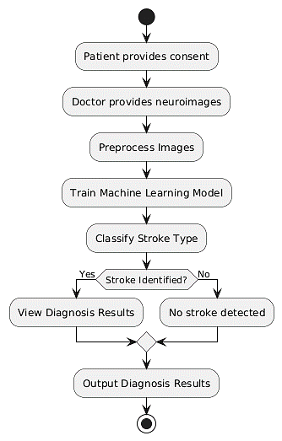
Use Case Diagram

Slide 25
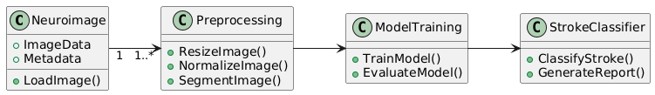
Class diagram

Slide 26
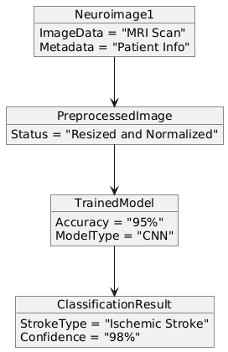
Object diagram

Slide 27
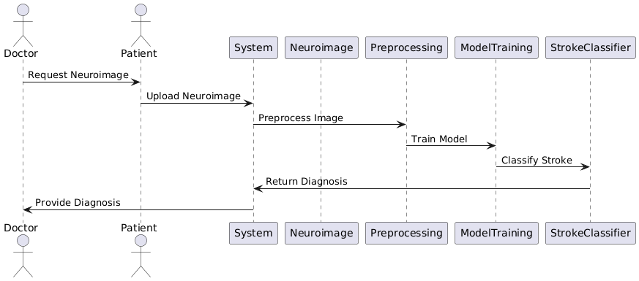
Sequence diagram

Slide 28
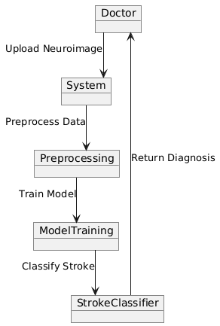
Collaboration diagram

Slide 29
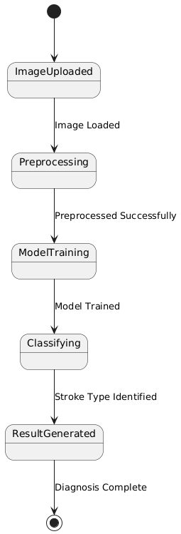
State chart diagram

Slide 30
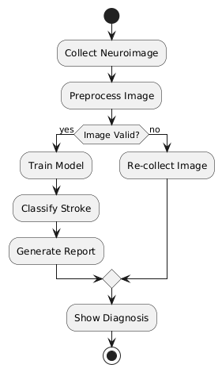
Activity diagram

Slide 31
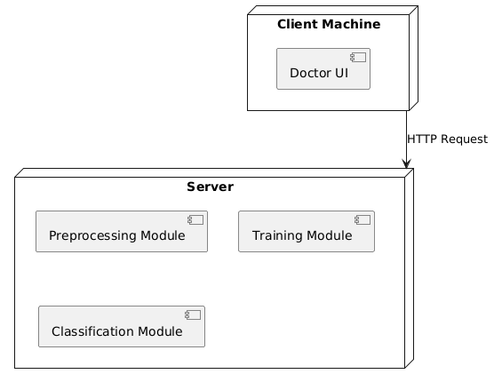
Deployment diagram
Result

Slide 32
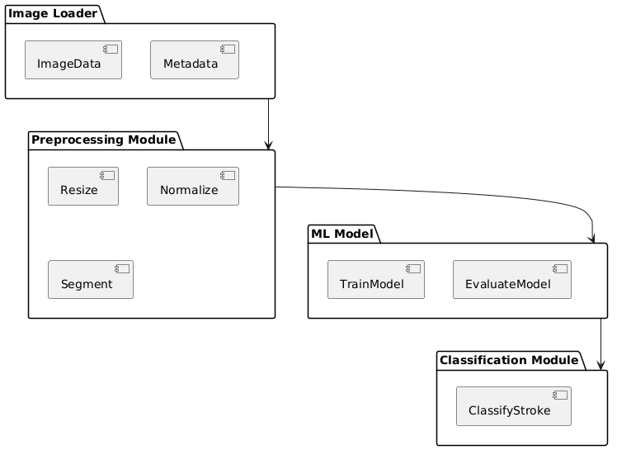
Component diagram

Slide 33
Conclusion
In conclusion, our project presents several innovative advancements in stroke diagnosis through the analysis of neuroimages. By utilizing state-of-the-art Convolutional Neural Network (CNN) techniques and incorporating larger, more diverse datasets, we significantly enhance both the accuracy and generalizability of stroke detection.
Moreover, the integration of clinical data with neuroimage analysis creates a comprehensive diagnostic tool that outperforms existing methods. This holistic approach not only improves the precision of stroke identification but also facilitates real-time assessment, making it invaluable for healthcare professionals. Ultimately, our solution aims to contribute to better patient outcomes and more efficient healthcare delivery in stroke management.

Slide 34

ANY QUIRIES?

Slide 35
THANK YOU

Slide 37
Instructions for use
If you have a free account, in order to use this template, you must credit Slidesgo by keeping the Thanks slide. Please refer to the next slide to read the instructions for premium users.
As a Free user, you are allowed to:
Modify this template.
Use it for both personal and commercial projects.
You are not allowed to:
Sublicense, sell or rent any of Slidesgo Content (or a modified version of Slidesgo Content).
Distribute Slidesgo Content unless it has been expressly authorized by Slidesgo.
Include Slidesgo Content in an online or offline database or file.
Offer Slidesgo templates (or modified versions of Slidesgo templates) for download.
Acquire the copyright of Slidesgo Content.
For more information about editing slides, please read our FAQs or visit our blog:
https://slidesgo.com/faqs and https://slidesgo.com/slidesgo-school

Slide 38
Instructions for use
If you have a free account, in order to use this template, you must credit Slidesgo by keeping the Thanks slide. Please refer to the next slide to read the instructions for premium users.
As a Free user, you are allowed to:
Modify this template.
Use it for both personal and commercial projects.
You are not allowed to:
Sublicense, sell or rent any of Slidesgo Content (or a modified version of Slidesgo Content).
Distribute Slidesgo Content unless it has been expressly authorized by Slidesgo.
Include Slidesgo Content in an online or offline database or file.
Offer Slidesgo templates (or modified versions of Slidesgo templates) for download.
Acquire the copyright of Slidesgo Content.
For more information about editing slides, please read our FAQs or visit our blog:
https://slidesgo.com/faqs and https://slidesgo.com/slidesgo-school

Slide 39
Instructions for use (premium users)
As a Premium user, you can use this template without attributing Slidesgo or keeping the Thanks slide.
You are allowed to:
Modify this template.
Use it for both personal and commercial purposes.
Hide or delete the “Thanks” slide and the mention to Slidesgo in the credits.
Share this template in an editable format with people who are not part of your team.
You are not allowed to:
Sublicense, sell or rent this Slidesgo Template (or a modified version of this Slidesgo Template).
Distribute this Slidesgo Template (or a modified version of this Slidesgo Template) or include it in a database or in any other product or service that offers downloadable images, icons or presentations that may be subject to distribution or resale.
Use any of the elements that are part of this Slidesgo Template in an isolated and separated way from this Template.
Register any of the elements that are part of this template as a trademark or logo, or register it as a work in an intellectual property registry or similar.
For more information about editing slides, please read our FAQs or visit our blog:
https://slidesgo.com/faqs and https://slidesgo.com/slidesgo-school

Slide 40
Fonts & colors used
This presentation has been made using the following fonts:
Inter
(https://fonts.google.com/specimen/Inter)
#cb3c3b
#fdf4f0
#601f1a
#fc8b87
#f36563
#fbe2ce

Slide 41





Storyset
Create your Story with our illustrated concepts. Choose the style you like the most, edit its colors, pick the background and layers you want to show and bring them to life with the animator panel! It will boost your presentation. Check out how it works.
Pana
Amico
Bro
Rafiki
Cuate

Slide 42
Use our editable graphic resources...
You can easily resize these resources without losing quality. To change the color, just ungroup the resource and click on the object you want to change. Then, click on the paint bucket and select the color you want. Group the resource again when you’re done. You can also look for more infographics on Slidesgo.

Slide 45
JANUARY
FEBRUARY
MARCH
APRIL
MAY
JUNE
PHASE 1
Task 1
Task 2
PHASE 2
Task 1
Task 2
JANUARY
FEBRUARY
MARCH
APRIL
PHASE 1
Task 1
Task 2

Slide 48
...and our sets of editable icons
You can resize these icons without losing quality.
You can change the stroke and fill color; just select the icon and click on the paint bucket/pen.
In Google Slides, you can also use Flaticon’s extension, allowing you to customize and add even more icons.

Slide 49
Educational Icons
Medical Icons

Slide 50
Business Icons
Teamwork Icons

Slide 51
Help & Support Icons
Avatar Icons

Slide 52
Creative Process Icons
Performing Arts Icons

Slide 53
Nature Icons

Slide 54
SEO & Marketing Icons

Slide 55


